Slide 1

Lead Scoring Case Study
By – Vishal Yadav

Slide 2
Agenda
Introduction
Steps/Procedures
Final Analysis/Inferences

Slide 3
Introduction
An education company named X Education sells online courses to industry professionals. On any given day, many professionals who are interested in the courses land on their website and browse for courses.
The company markets its courses on several websites and search engines like Google. Once these people land on the website, they might browse the courses or fill up a form for the course or watch some videos.
When these people fill up a form providing their email address or phone number, they are classified to be a lead. Moreover, the company also gets leads through past referrals.
Once these leads are acquired, employees from the sales team start making calls, writing emails, etc. Through this process, some of the leads get converted while most do not. The typical lead conversion rate at X education is around 30%.
Now, although X Education gets a lot of leads, its lead conversion rate is very poor. For example, if, say, they acquire 100 leads in a day, only about 30 of them are converted. To make this process more efficient, the company wishes to identify the most potential leads, also known as ‘Hot Leads’.

Slide 4
If they successfully identify this set of leads, the lead conversion rate should go up as the sales team will now be focusing more on communicating with the potential leads rather than making calls to everyone. A typical lead conversion process can be represented using the following funnel:
Lead Conversion Process - Demonstrated as a funnel As you can see, there are a lot of leads generated in the initial stage (top) but only a few of them come out as paying customers from the bottom.
In the middle stage, you need to nurture the potential leads well (i.e. educating the leads about the product, constantly communicating etc. ) in order to get a higher lead conversion.
X Education has appointed you to help them select the most promising leads, i.e. the leads that are most likely to convert into paying customers. The company requires you to build a model wherein you need to assign a lead score to each of the leads such that the customers with higher lead score have a higher conversion chance and the customers with lower lead score have a lower conversion chance.
The CEO, in particular, has given a ballpark of the target lead conversion rate to be around 80%.

Slide 5
GOAL
Build a logistic regression model to assign a lead score between 0 and 100 to each of the leads which can be used by the company to target potential leads. A higher score would mean that the lead is hot, i.e. is most likely to convert whereas a lower score would mean that the lead is cold and will mostly not get converted.

Slide 6
Procedures
Understanding the Data
Data Cleaning and Visualisation
Exploratory Data Analysis
Data Preparation
Choose a Model & Train the Model
Model Evaluation
Make Predictions

Slide 7
Understanding the Data : Understand the attributes of the data. Summarize the data by identifying key characteristics, such as data volume and total number of variables in the data. Understand the problems with the data, such as missing values, inaccuracies, and outliers.
lead = pd.read_csv('Leads.csv')
lead.head()
lead.shape
lead.info()
round(100*lead.isnull().sum()/lead.shape[0],2)
lead.describe()

Slide 8
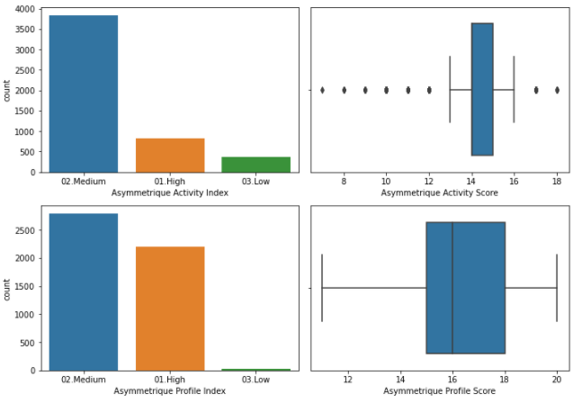
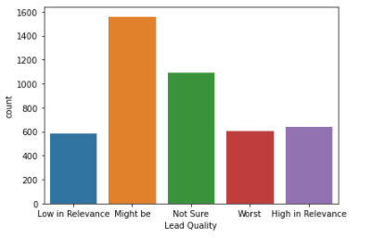
Data Cleaning and Visualisation : Identifying the incorrect, incomplete, inaccurate, irrelevant or missing part of the data and then modifying, replacing or deleting them according to the necessity.
The graphical representation of information and data is called visualisation. All the features are visualised using count plot, boxplots, bar graphs etc.

Slide 9
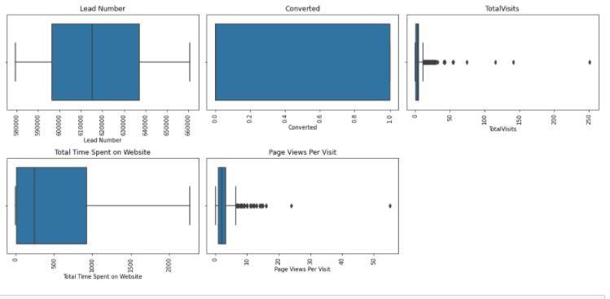
Exploratory Data Analysis : Exploratory Data Analysis is a crucial step before you jump to machine learning or modelling of your data. It provides the context needed to develop an appropriate model – and interpret the results correctly.

Slide 10
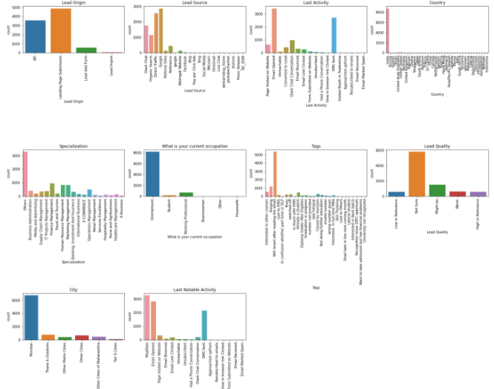
Categorical Features

Slide 11
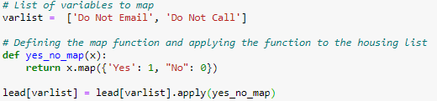

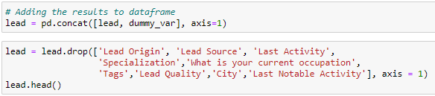
Data Preparation : Data preparation (also referred to as “data pre-processing”) is the process of transforming raw data so that data scientists and analysts can run it through machine learning algorithms to uncover insights or make predictions.

Slide 12
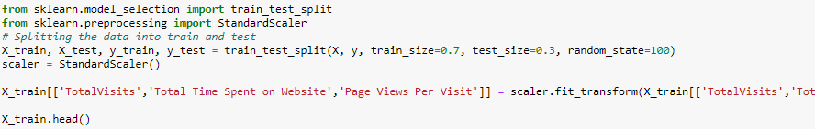
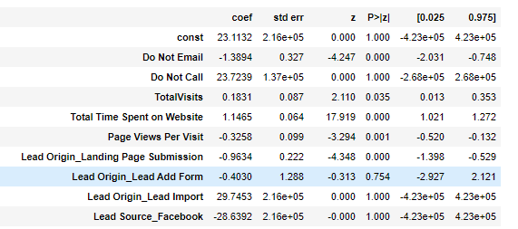
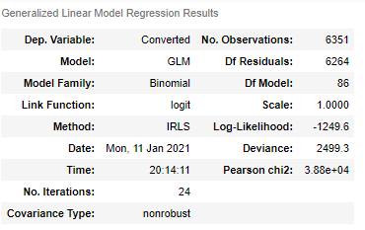
Choose a Model & Train the Model : The process of training an ML model involves providing an ML algorithm (that is, the learning algorithm) with training data to learn from. The term ML model refers to the model artifact that is created by the training process.

Slide 13
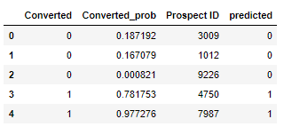
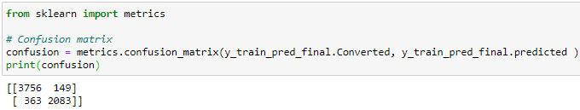
# Getting the predicted values on the train set
y_train_pred = res.predict(X_train_sm)
y_train_pred_final = pd.DataFrame({'Converted':y_train.values, 'Converted_prob':y_train_pred})
y_train_pred_final['Prospect ID'] = y_train.index
y_train_pred_final['predicted'] = y_train_pred_final.Converted_prob.map(lambda x: 1 if x > 0.5 else 0)

Slide 14
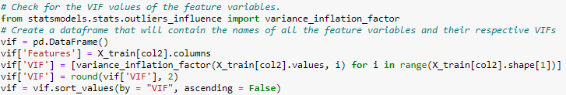
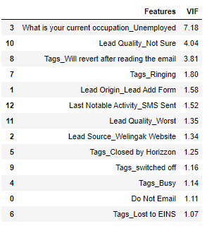
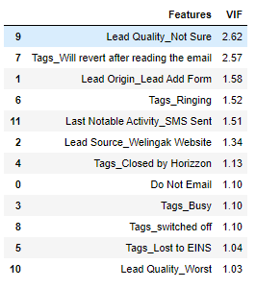
Model Evaluation : Model Evaluation is an integral part of the model development process. It helps to find the best model that represents our data and how well the chosen model will work in the future.
To a better VIF

Slide 15
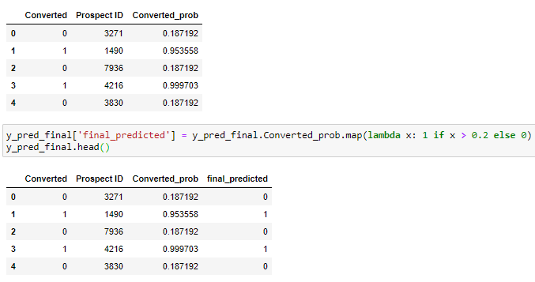
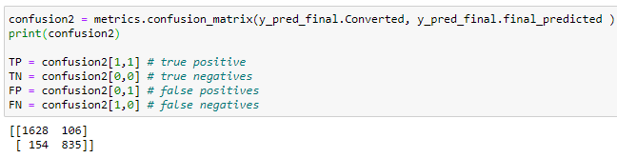
Make Predictions : Prediction” refers to the output of an algorithm after it has been trained on a historical dataset and applied to new data when forecasting the likelihood of a particular outcome, such as whether or not a customer will be converted to take the course.

Slide 16
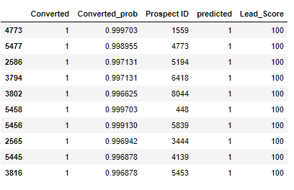
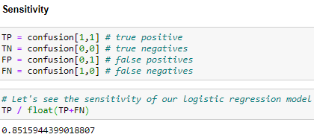
Final Analysis/ Inferences
The sensititvity turns out to be approx 85% which is much greater than the initial (30%). Hence it is good to say that the aim is achieved and selected features are obtained which contribute most to enhance probability.

Slide 17
Some Inferences :
Converting 'Select' values to NaN.
Replacing null values in categorical features with most occurring value and small categories to “Others”.
Based on the univariate analysis we have seen that many columns are not adding any information to the model, hence we can drop them for further analysis. Like 'Lead Number', 'What matters most to you in choosing a course', 'Search', 'Magazine', 'Newspaper Article' etc.
Converting some binary variables (Yes/No) to 1/0.
Calculating accuracy (~92%) and sensitivity (~85%)

Slide 18


